Slide 1
Cranium Cafe Steps
Los Angeles Mission College
Financial Aid Oﬃce
Helping students on how toaccess our services during the
Safer at Home period.
April 1, 2020

Slide 2
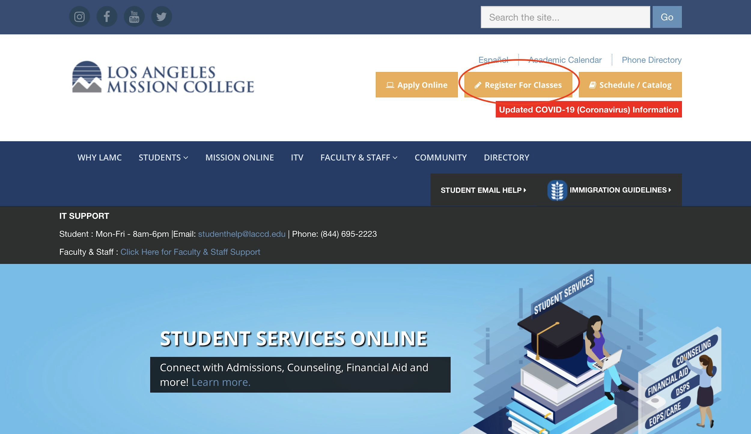
LAMC Home Website
lamission.edu

Slide 3
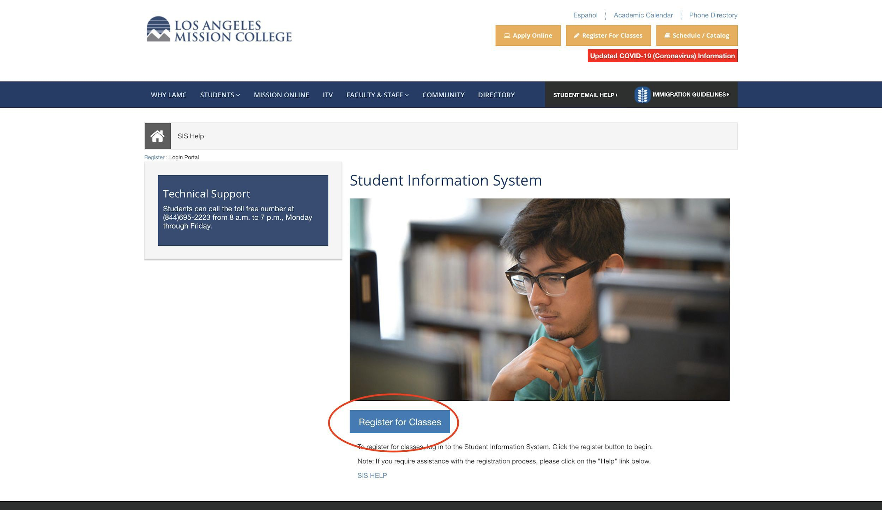
How to Access SIS Portal

Slide 4
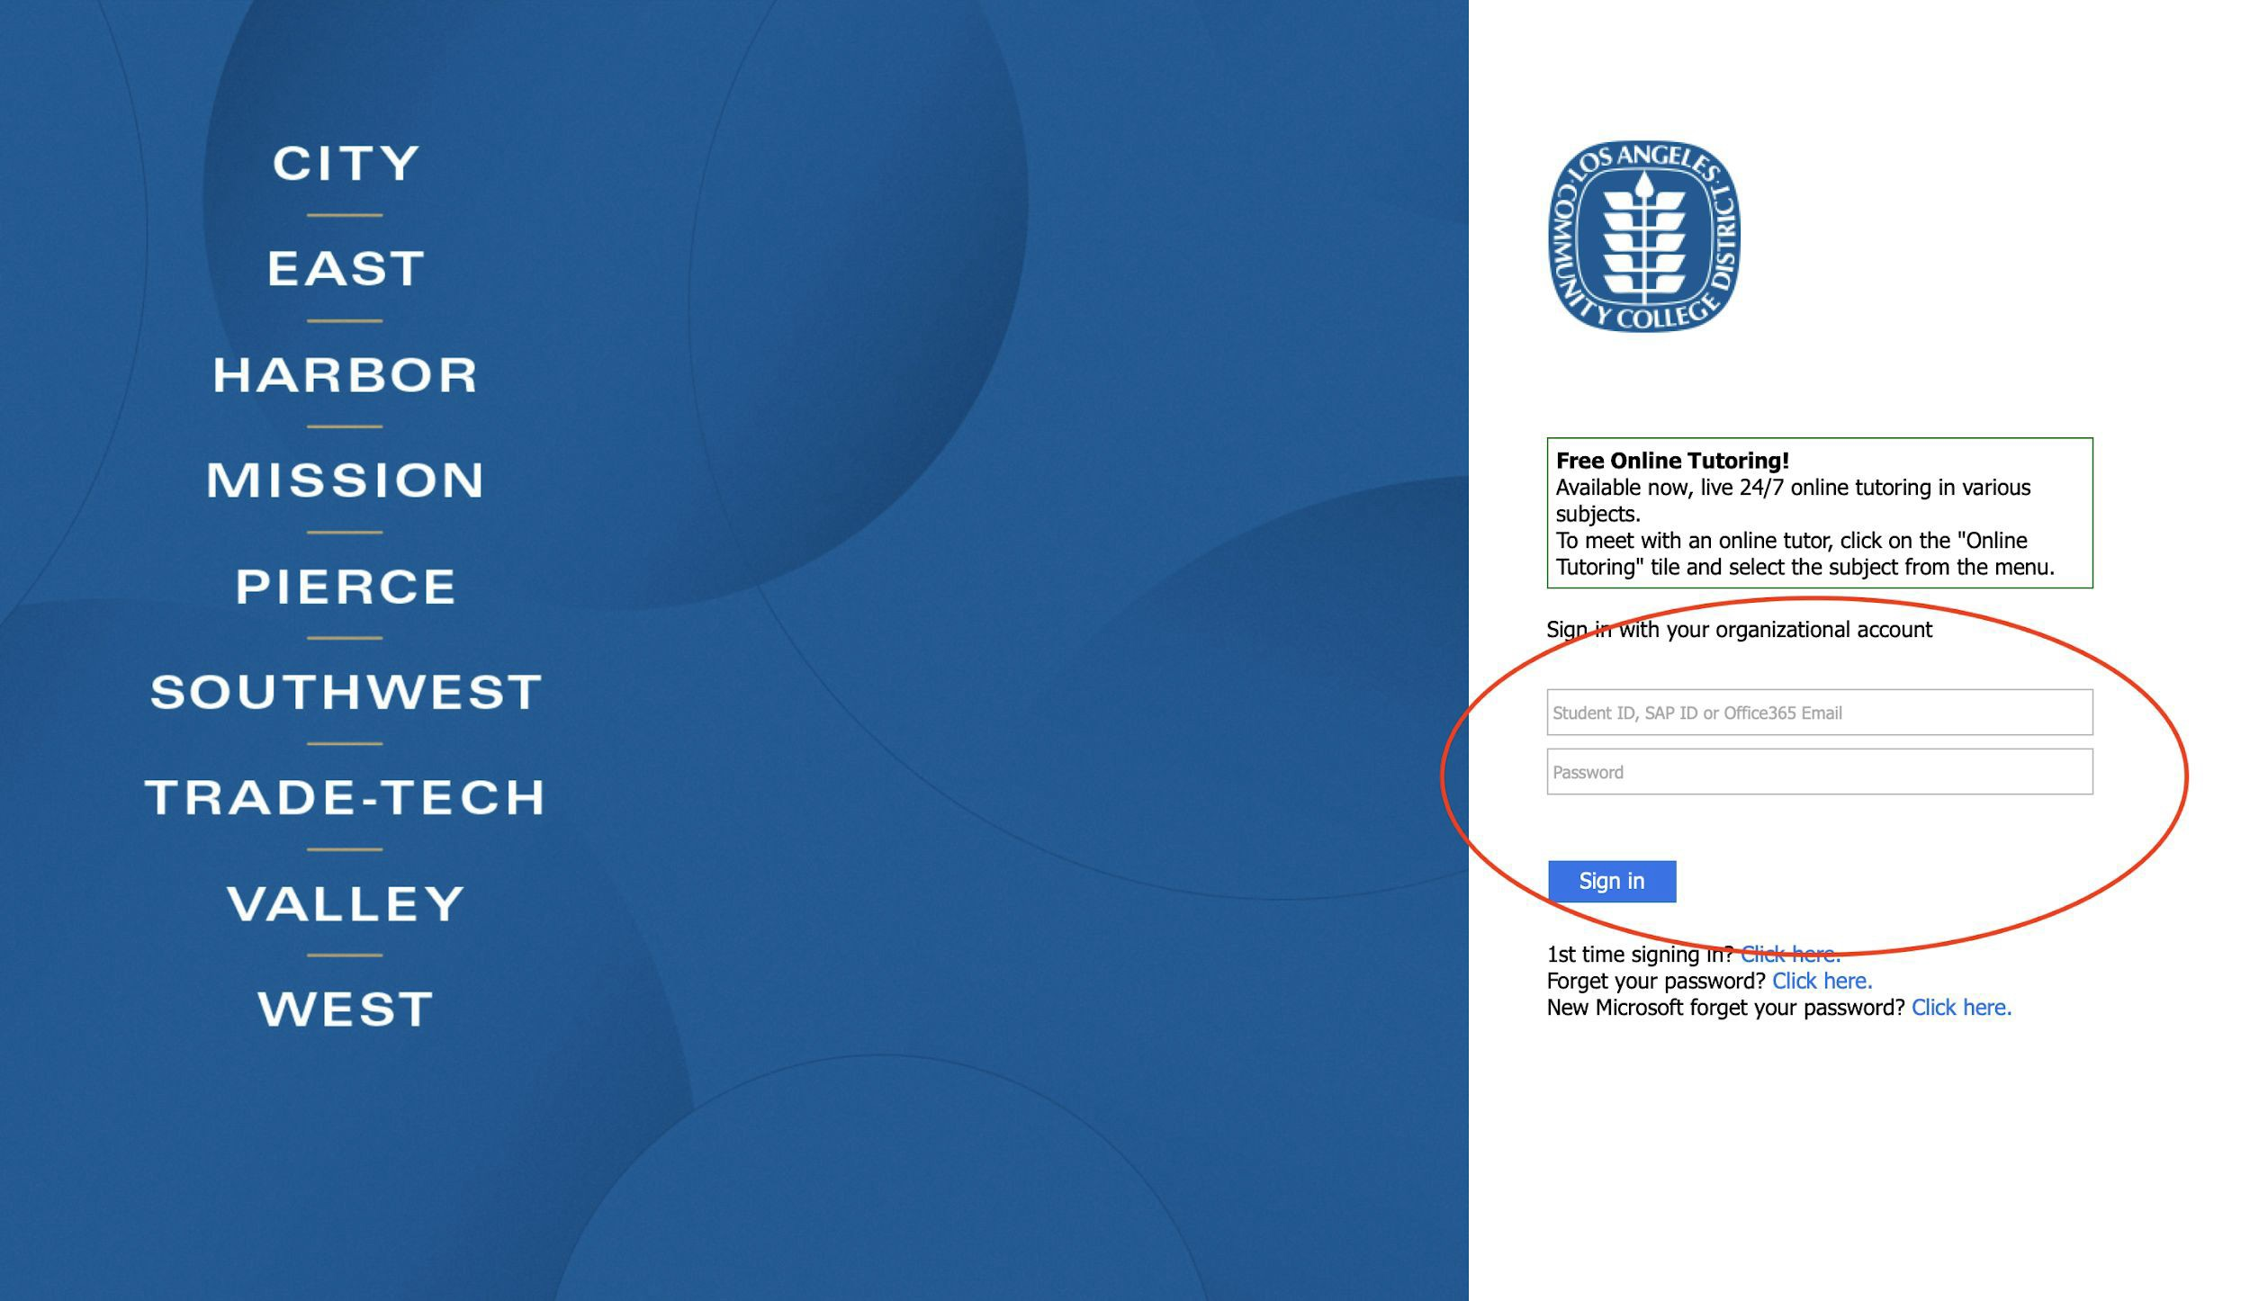
Signing into SIS Portal
Student ID Number and Password

Slide 5
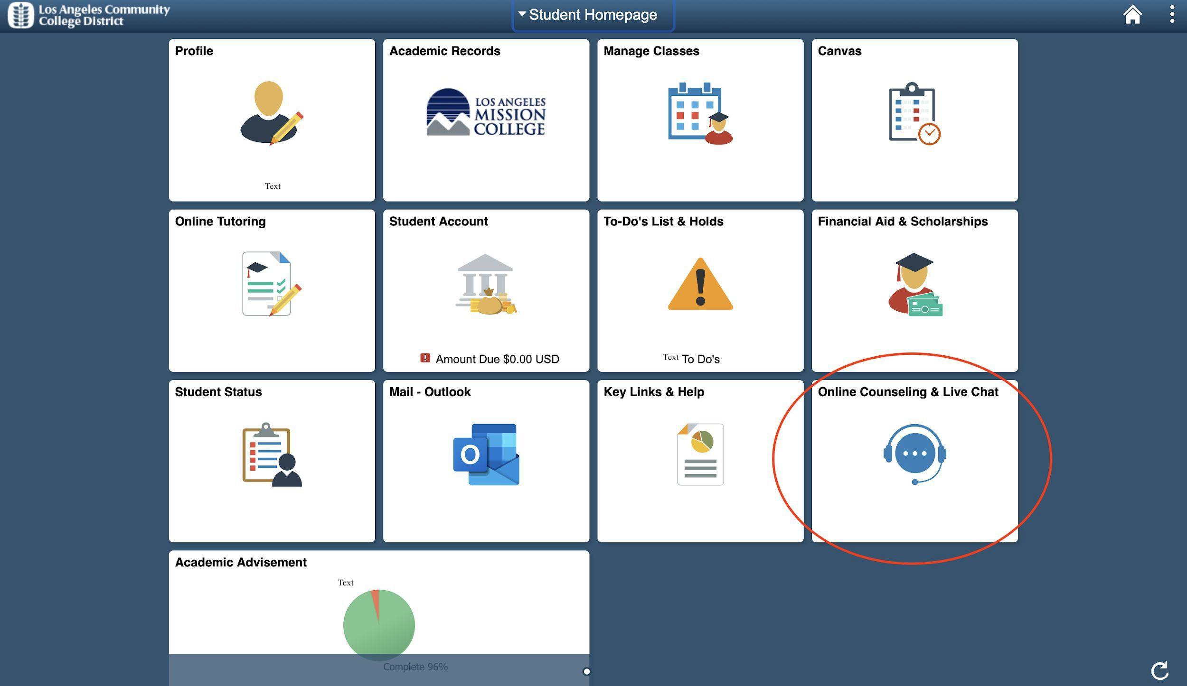
How to Reach us on ConexED/Cranium Cafe

Slide 6
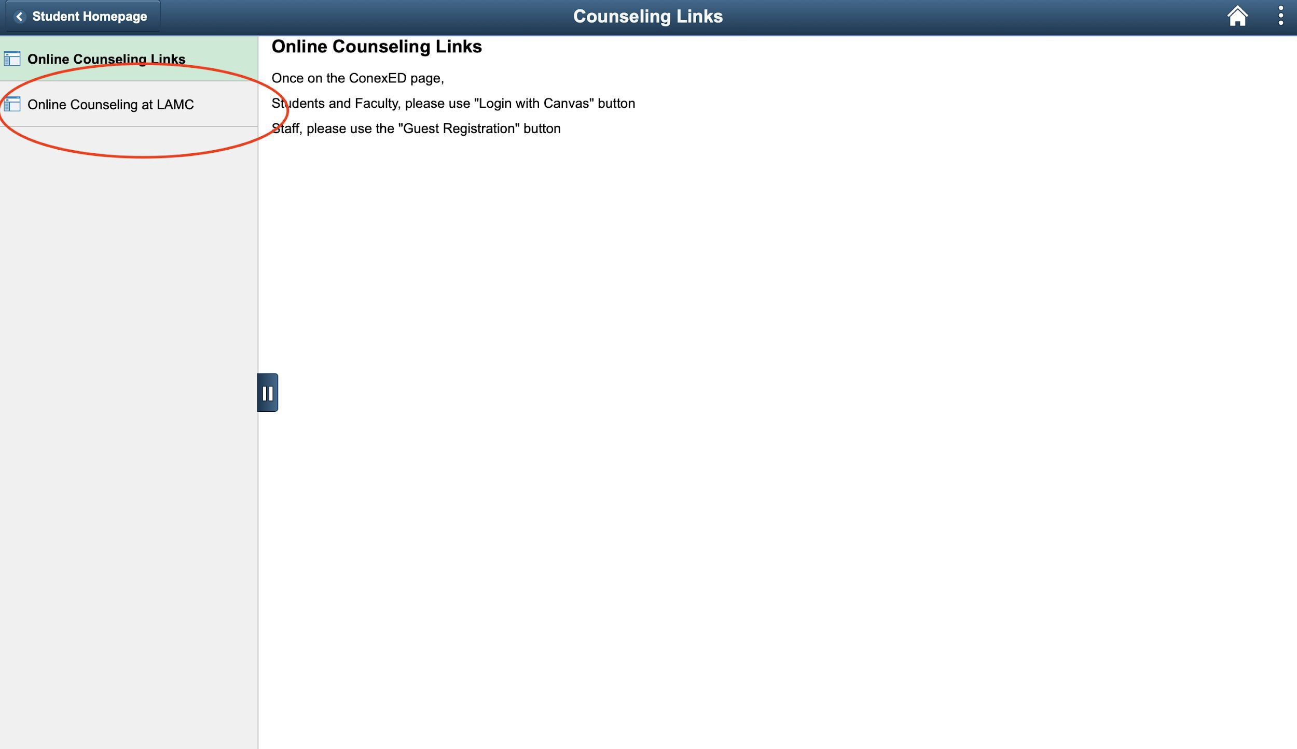
Accessing ConexED/Cranium Cafe

Slide 7
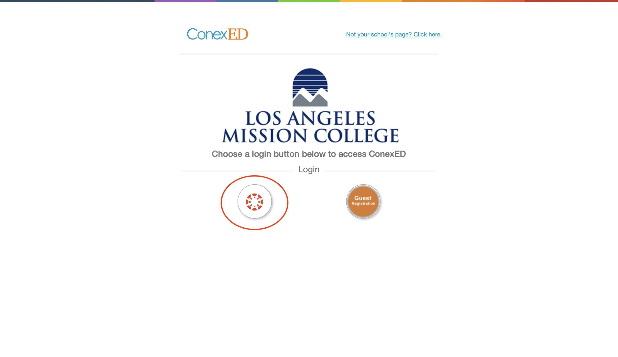
Select the Canvas logo

Slide 8
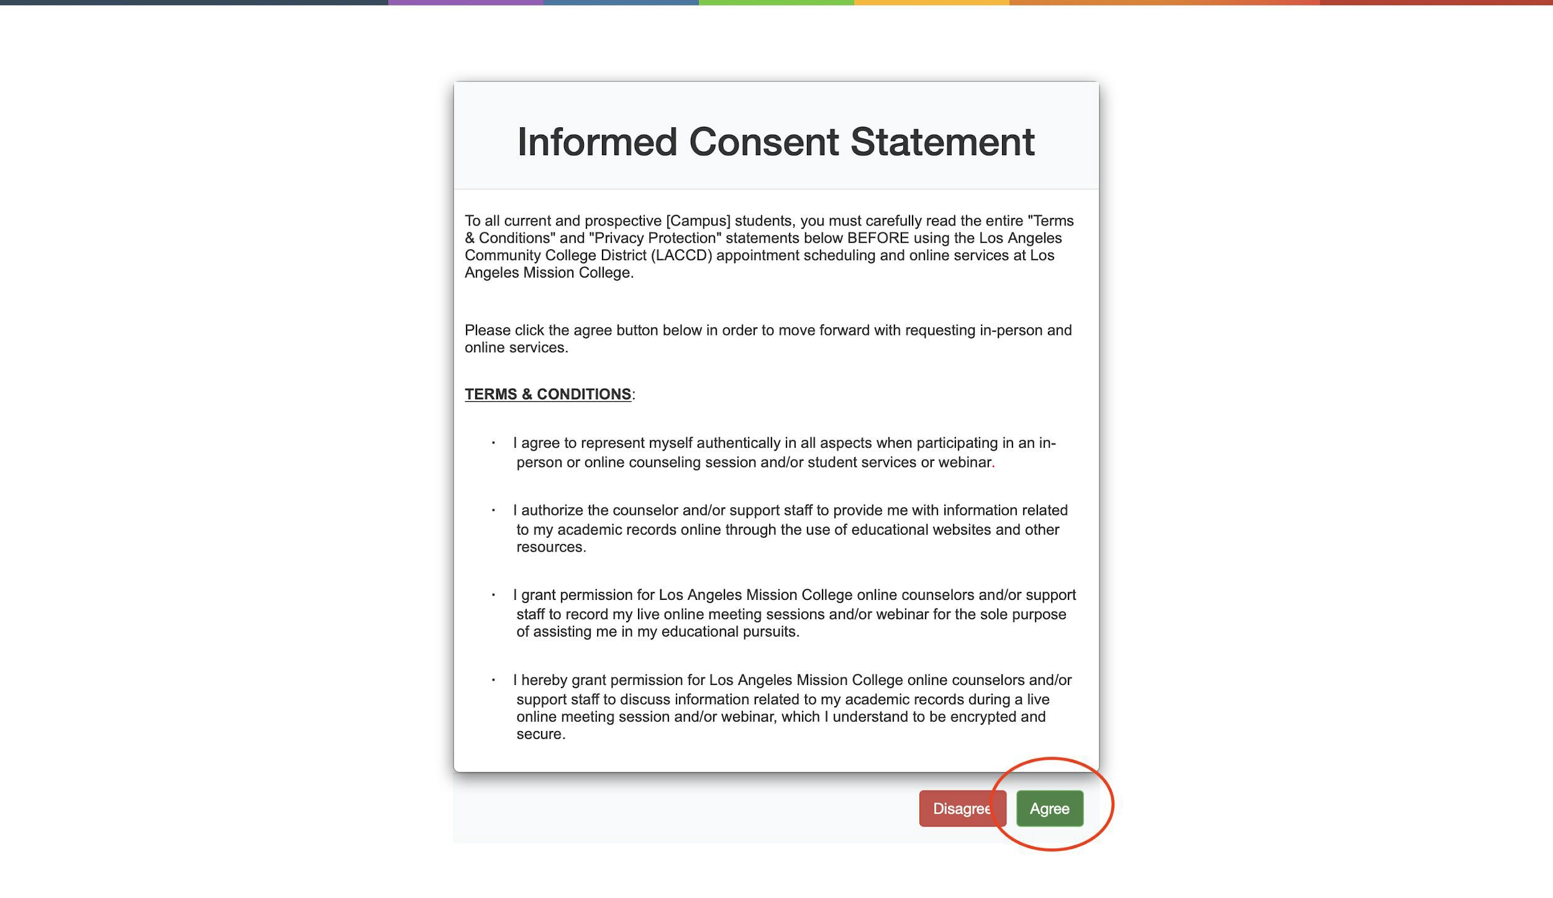
Agree to Terms to use ConexED

Slide 9
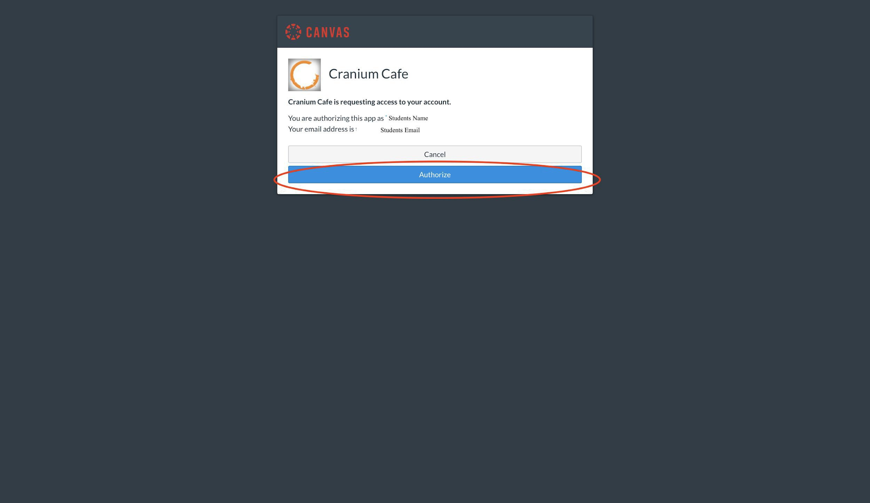
Authorize Access

Slide 10
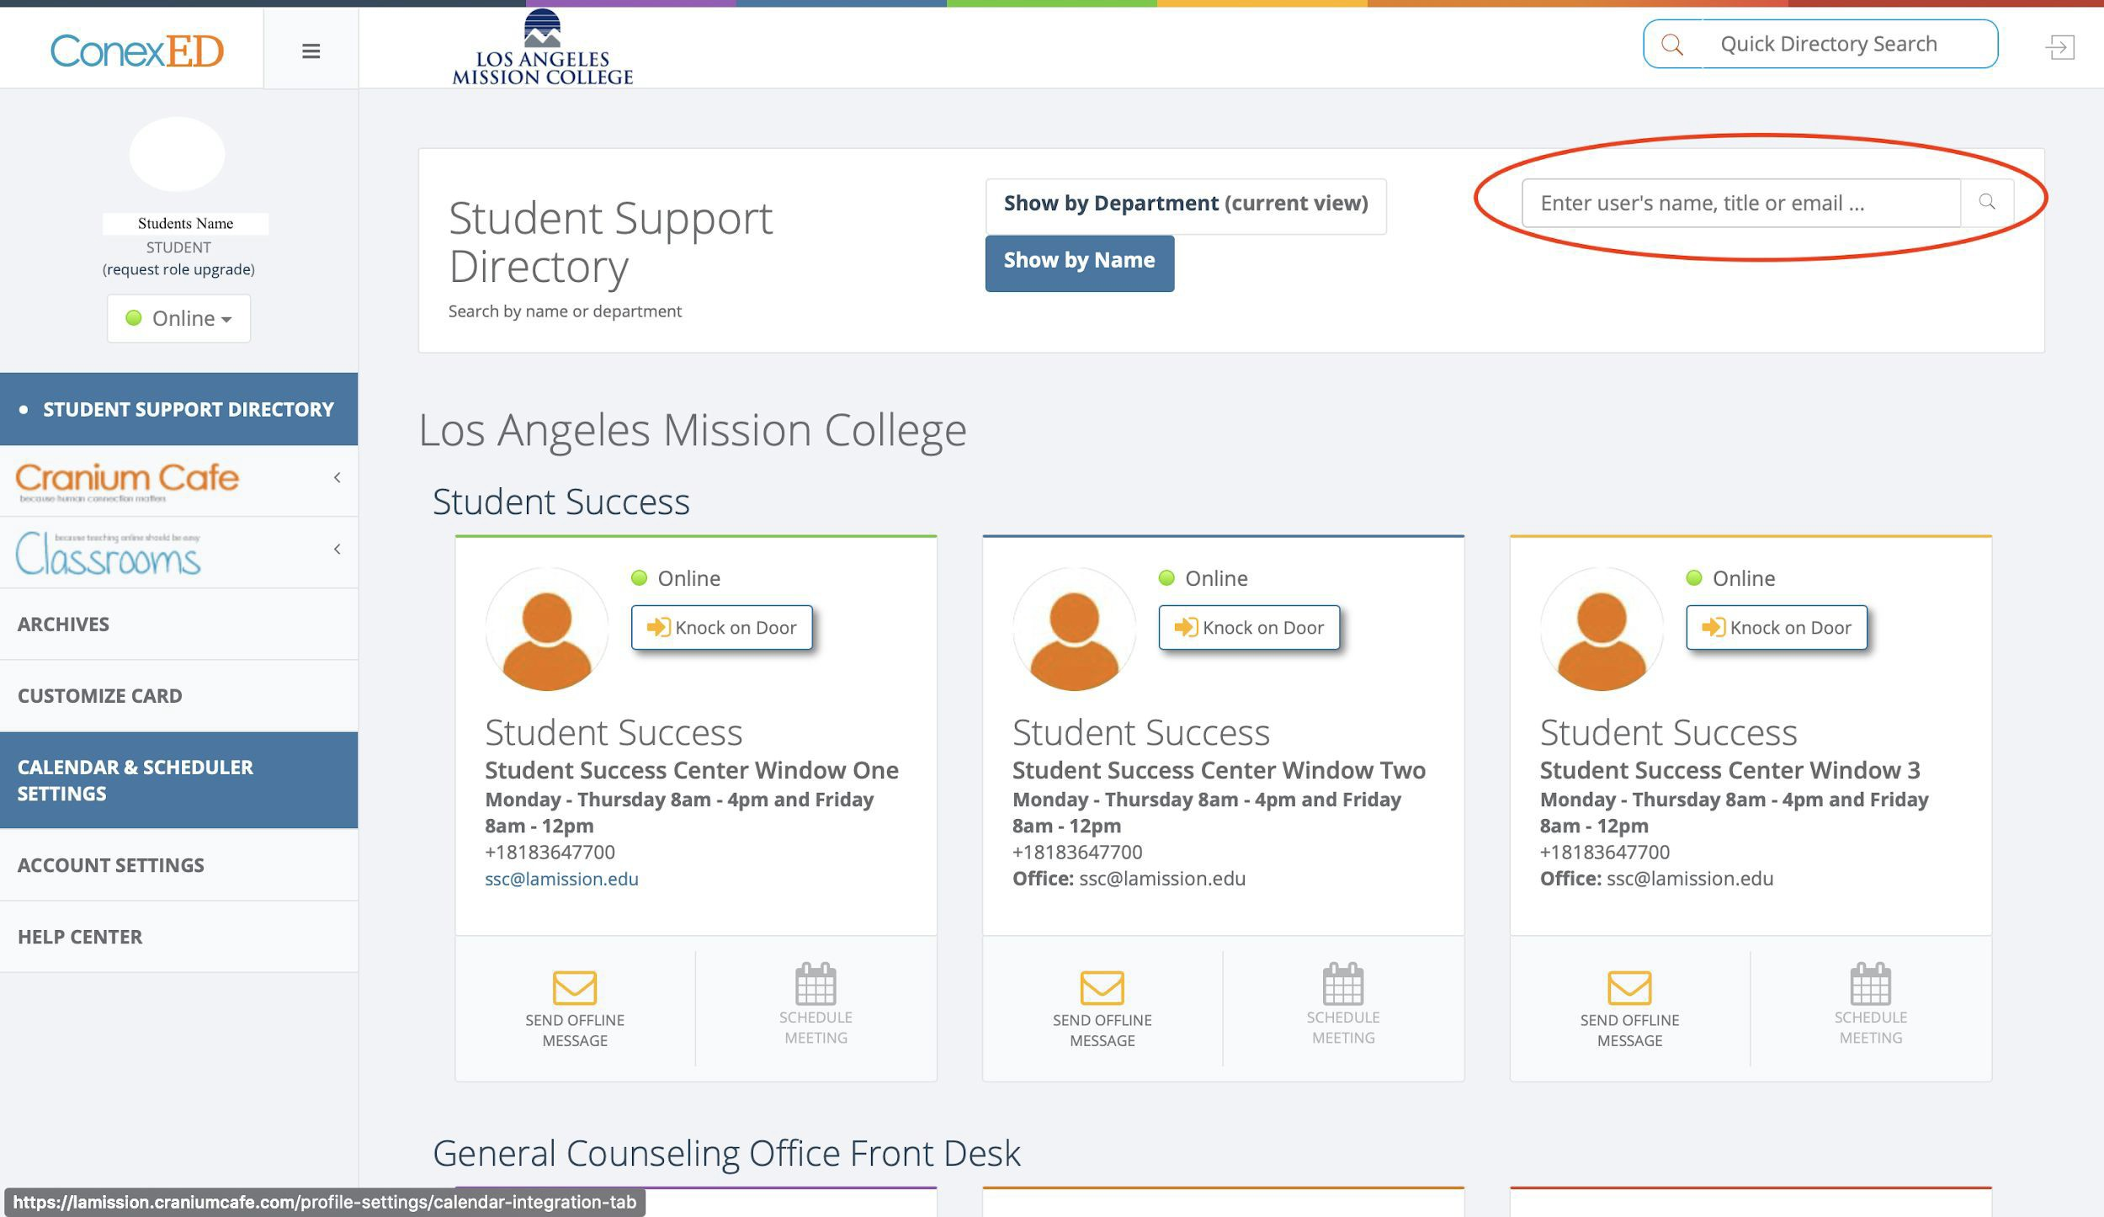
Search for the Financial Aid Window

Slide 11
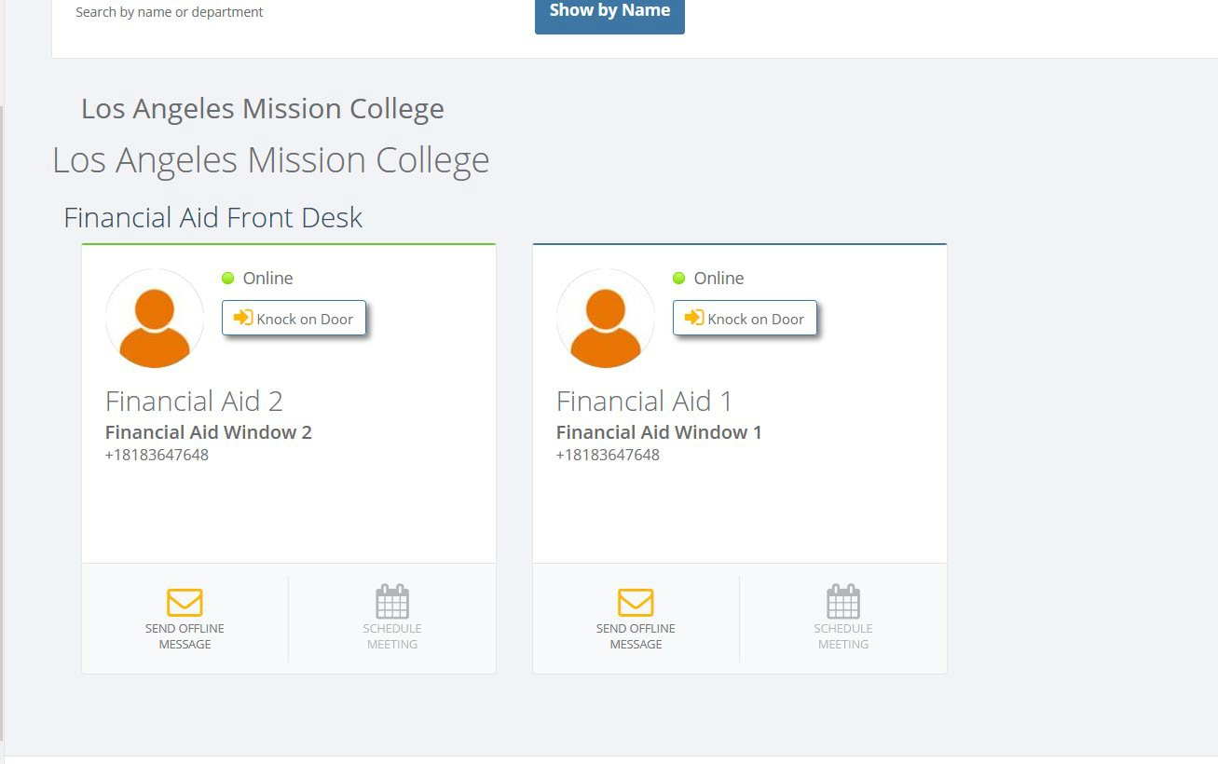
Online Communication
Live chat &Video chat available

Slide 12
Ofﬂine Communication

Slide 13
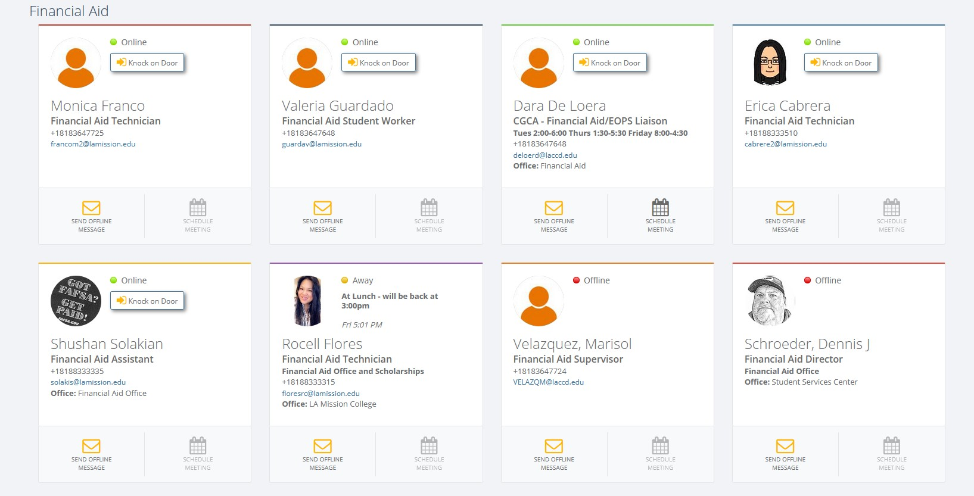
Financial Aid Staff Members ConexED/Cranium Cafe Accounts

Slide 14
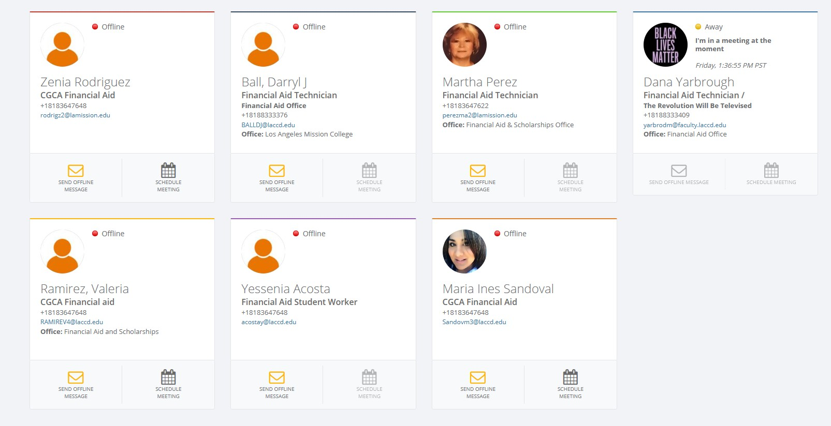
Financial Aid Staff Members ConexED/Cranium Cafe Accounts

