Slide 1
Strategy for the Semester
Notes:
Slides by Diane Livio, Life Sciences

Slide 2
Talk to this text: an excerpt from the book Freedom to Learn
A Thoughtful Exercise
Notes:
Have the students spend 5 – 10 min with the excerpt from the Freedom to Learn text. Point out to them that there quote has been formatted to provide plenty of space for them to record notations of every thought that they have as they read. They should take their time and be conscientious of their thought process without filtering – write down any questions, thoughts, connections, etc that come to mind.

Slide 3
Reflect and Share
What did you think of this reading selection?
Do you agree with it?
What parts seemed particularly relevant to you?
What can we take away from this as we consider upcoming exams?
Notes:
Give the students 5 min to share their thoughts with each other about this quote – do you they want to challenge any part of it? Was anything particularly interesting or thought-provoking? What can they take away from reading this?

Slide 4
Schedule of a Student
When you enroll in a course, what is the commitment you’re making?
Consider the expectations the instructor has of the students
Consistency needed like a job
How many hours devoted per week, in or out of the class?

Slide 5
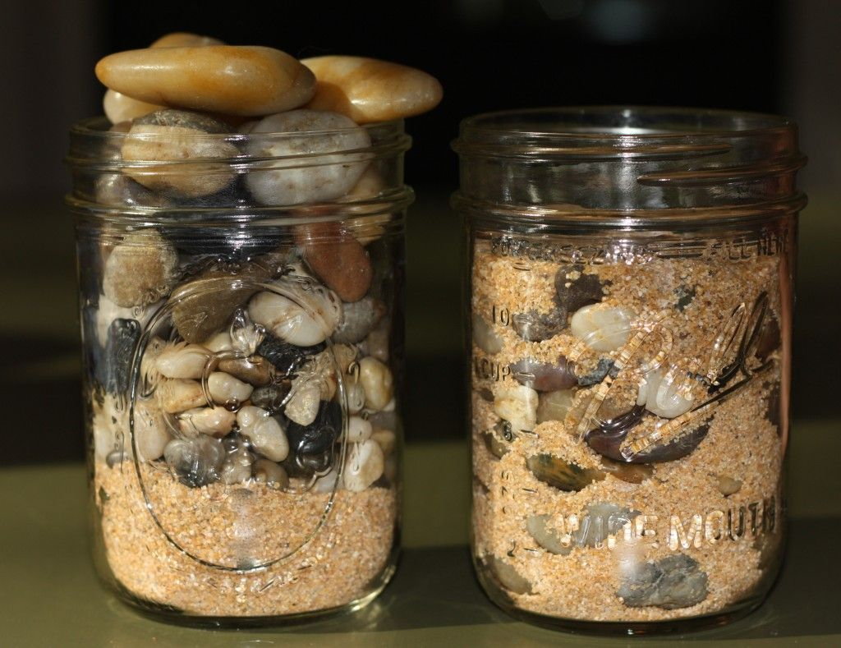
Invest for Success
Take a look at your weekly schedule
Time for classes, job(s), family, other obligations
When are you working on homework? Studying?
When an exam comes up, how much time is needed to prepare for it?
Notes:
The students can use the week grid to be honest with themselves about how much time they devote to everything in their life and see if there are times that aren’t used efficiently or could be better devoted to their obligations from their classes
The picture is the metaphor about how we make time for everything in our life – need to prioritize! Most important stuff first, the big stuff that keep us alive and stable goes in the jar first to take care of ourselves and our health… meet your most important obligations with family, work, school… then you can fill in the gaps with the smaller stuff - if you put too much time and focus on the less important stuff, you’ll run out of time or burn out without being able to fit in the big stuff
It’s important to be honest with oneself about how much time they need to feel confident on the material for a class, time beyond the minimum needed to complete homework and attend classes – do you spread this time out over multiple days or try to accomplish it with one big cram session?
It’s helpful to mark down time for homework and studying to remember to keep it available each week!

Slide 6
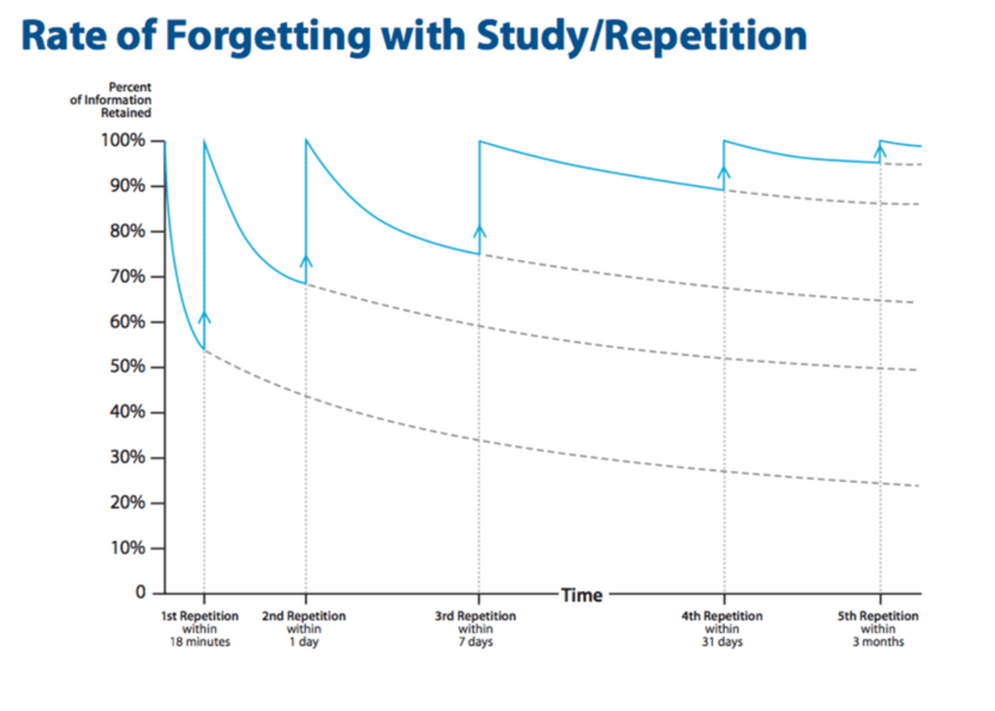
What is this graph demonstrating?
How is this relevant to you and your courses?
Notes:
Have the students take a few minutes to interpret the graph and consider what it represents
Conclusion: it’s better to set aside time throughout the week on multiple days, even if for short periods of review, than to wait until one big cram session – especially since it will be hard to stay efficient and focused for long periods of time without getting tired or stressed out

Slide 7
How do you feel right before a test?
Have you ever felt anxious about taking a test?
Notes:
Ask the students to take a moment to be honest and consider the last time they felt anxious about taking a test – reminding them this is a supportive environment, so it’s ok to feel vulnerable. Most people have at least one subject they feel particularly nervous about when it comes to exam time, and a math test is certainly a commonly shared source of worry!

Slide 8
Regularly and actively engaging with course content improves confidence!
“Contrary to the popular notion, memories are not stored in our brains like books on library shelves, but must be actively reconstructed from elements scattered throughout various areas of the brain by the encoding process. Memory storage is therefore an ongoing process of reclassification resulting from continuous changes in our neural pathways, and parallel processing of information in our brains.”
Mastin 2019
Notes:
Quote is from The Human Memory website: http://www.human-memory.net/processes_storage.html

Slide 9
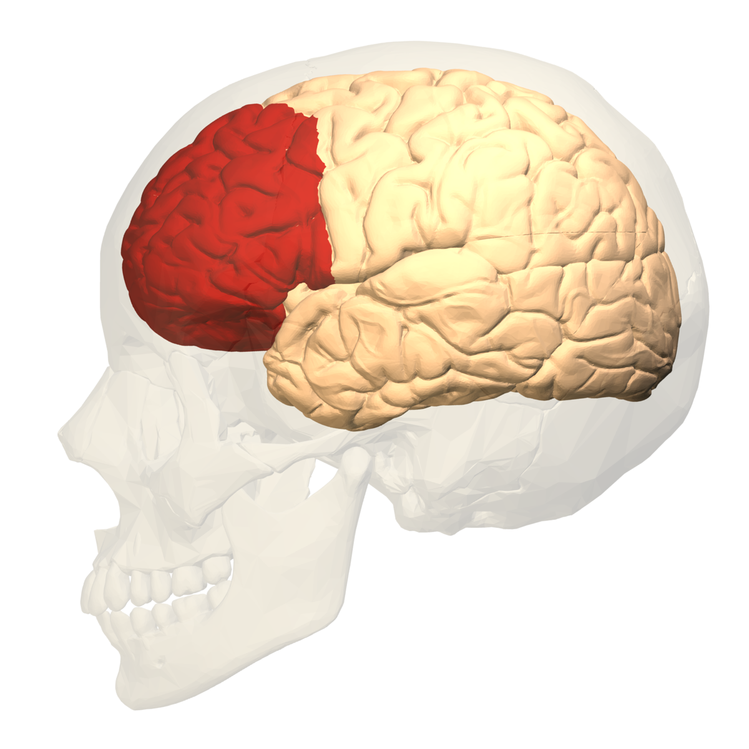
Regularly and actively engaging with course content improves confidence!
You’re activating the conscious, “voluntary” parts of your brain, such as the region for decision making.
Notes:
Your cerebral cortex has neural networks that you are consciously aware of and voluntarily control, such as in the prefrontal cortex marked in the image, which is important in decision making.
What does this mean?

Slide 10
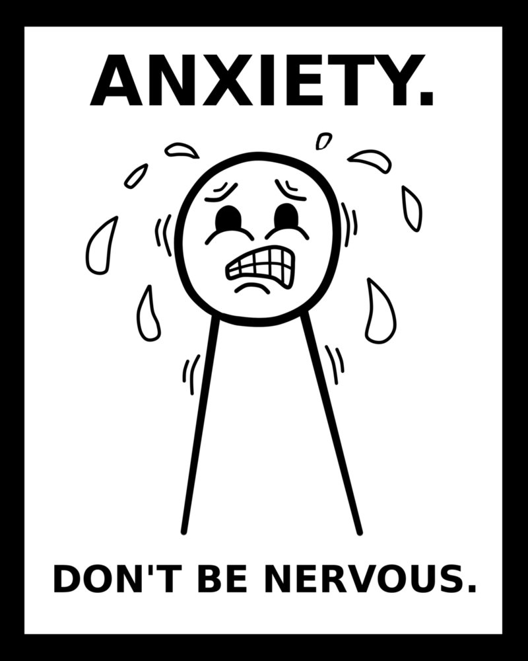
This COUNTERS the involuntary activity of the fight-or-flight response!
Feeling stressed or anxious?
Your brain is just trying to protect you from a perceived danger, and sometimes it overestimates...
And this can be an unnecessary distraction!
Notes:
Have you noticed that when you are feeling anxious or scared, someone telling you “don’t worry, don’t worry, don’t worry” doesn’t really stop your feeling of worry? If anything, it might make it worse, as your brain wonders “is that because there actually is something to worry about?”
Feeling stressed, scared, or anxious is connected to the sympathetic nervous system, the parts of our brain and nerves that trigger the fight-or-flight response of increased heart rate, tightening of the stomach, increased breathing rate, etc… We don’t have conscious control of this, it just happens as reflex. (Try to tell your heart to beat faster… doesn’t work that way.)
Anxiety in particular is when this neural network is over active – the brain interprets some signals as a threat and is trying to automatically fire up parts of your body to keep you safe. But this can create a loop of anxious thoughts that will distract your conscious awareness from what’s really going on – doing some math problems, taking a test, reading a challenging text, etc…

Slide 11
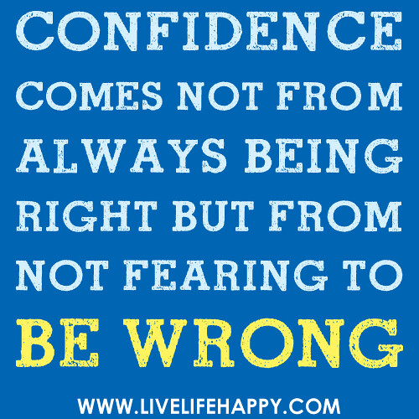
How can we counter the distracting anxious thoughts?
Acknowledge the worry, then set it aside!
Acknowledge your efforts!
Notes:
“I’m going to fail this, I don’t know anything!” → “That would be unfortunate and does sound scary, but I do in fact know quite a lot. I did my homework. I studied multiple times throughout the week. I talked to tutors. I took lots of notes. I got this.”
Marking up the test with the “talking to the text” technique is a way to shift your brain activity from the involuntary stress response to the voluntary thought processes you need to engage to answer questions
By investing pockets of focused time throughout your schedule, you’ll have more to draw confidence from when you need it!

Slide 12
From a professor: what to consider when you want to improve in a course
What materials are you using? (textbook, notes, youtube…)
Are there potential distractions? (phone, social media, people…)
Are you actively challenging yourself as you study?
What can you do to make class time more effective and useful?
How often and when do you review the material?
Notes:
OPTIONAL
If a student asks me how they can do better on tests, these are the kinds of questions I will ask to get them to be honest with themselves about what will be a more effective and efficient use of their study time
Are they utilizing all the resources available?
Are they setting aside time that is free from distractions to maintain focus? (Pomodoro technique recommends 25 min on a kitchen timer, focusing on one task with phone on silent, then taking a 5min break)
Are they taking an active approach to their studying, beyond just reading the text or rushing to just get the right answers on the homework problems without paying attention to their problem-solving process?
Are they taking thoughtful notes during class, making notations of questions or insights, beyond just copying what the instructor says or writes?
Are they only reviewing the material after class or when they are completing the associated homework assignment, as opposed to skimming before class and reviewing throughout the week?

