Slide 1
“Talking to the Text”
(in writing…)
Diane Livio
Reading Apprenticeship Network
Schoenbach, R., Greenleaf, C., Murphy, L. 2012. Reading for Understanding: How Reading Apprenticeship Improves Disciplinary Learning in Secondary and College Classrooms. San Francisco, CA: Jossey-Bass.

Slide 2



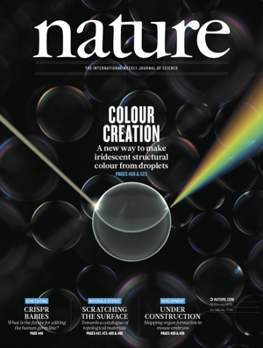
Disciplinary Texts:
How We Use Them
What is your experience with them?
Notes:
Take a moment to reflect on the type of texts we need to access for our math and science classes. What are some of them?
How accessible are they to read and get the information you need? How consistent is that experience?
Tutors and professors seem to know everything and seem like they don’t have trouble with these texts – do you think that’s always been the case? What do you think it took to get them to this point of comfort with the text?
It’s understandable that a math or science based text feels intimidating or if you don’t feel a connection with the text at first – but if you draw on your background knowledge and skill sets, you can find ways to feel more confident to tackle a challenging text

Slide 3
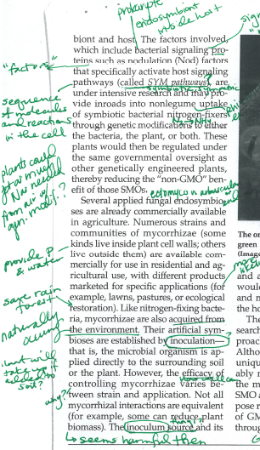
What is “Talking to the Text”?
Marking the paper with your thoughts while you read
No filter!
Notes:
Talking to the Text is a strategy to keep yourself more involved with the text, an Active Reading Strategy, that works well as a problem-solving routine, particularly for more challenging texts or question prompts
Write down any and all thoughts that come to mind while reading or interpreting images, without trying to apply a filter on what you write. This way you get the thoughts out of your head and onto the paper to keep better track of them and avoid distractions (like unanswered questions or doubts) from slowing you down.
Notice that this is more than just highlighting, underlining, or circling words. If a part of the text is marked, there are matching notations for WHY it is marked.

Slide 4
Set the intentions
Practice metacognitive conversation with the text
What Do I Know vs
What Do I Have Questions About?
Critical reading like a master
“Metacognitive Funnel” from Reading for Understanding, p.128
Notes:
This technique is intended to help you stay connected and engaged, to make the most of your time while studying or make sure you don’t miss important details that will be helpful context cues for yourself.
Metacognition is basically “thinking about your thinking” or being aware of your thought process as you grapple with potentially difficult text. There is a metaphor of a metacognitive funnel that describes how the reader’s attention may shift while reading a text. By practicing being aware of your thought process, it becomes easier to recognize how and when your attention can shift between different kinds of focus – it also becomes easier to set intention for your reading to consciously put aside distractions and make the most of your reading, especially when time can be limited. This can help you take control of any thoughts of self-doubt or worry that might make you feel disconnected from the text, to instead focus on what you CAN do to understand it.
An important skill to being efficient and effective with your text is to become consciously aware of what you do not understand, identifying your questions, to shift your focus on what you can do to improve your understanding
Part of developing the disciplinary literacy skills that are needed to master content in your math or science course is being able to distinguish for yourself what is relevant, what is helpful, when things will be useful for you, etc.

Slide 5
Time to talk to the text!
Pay attention to your thoughts as you read
Write on the text to track thoughts, connections, predictions, & questions
More than just underlining! Mark why…
There’s no need to finish the text
Notes:
Try to give them at least 10 min, if possible
Emphasize that they don’t need to finish the text, so take their time with it at whatever feels comfortable for them

Slide 6
Time to share!
Make sure everyone contributes their thoughts from the reading!
Start by saying where in the text you are referencing, then let your partner(s) find that spot
  What questions do you have from the text?
  Was any language confusing or challenging?
  What seemed like an important line to remember?
  What did the text remind you of?
  How is it relevant to what you are learning?
Notes:
Ask them to make sure they direct the partner to the location in the text that they made a notation on, so that they’re able to follow along
After they share with each other for awhile, ask them to share with the group – what did their partner note that was different or interesting?

Slide 7
New Skill Acquired!
Practice, practice, practice…
Where will this technique be a helpful tool to use?
Notes:
Consider difficult text excerpts, trouble understanding the homework, long or difficult exam prompts…

