Slide 1
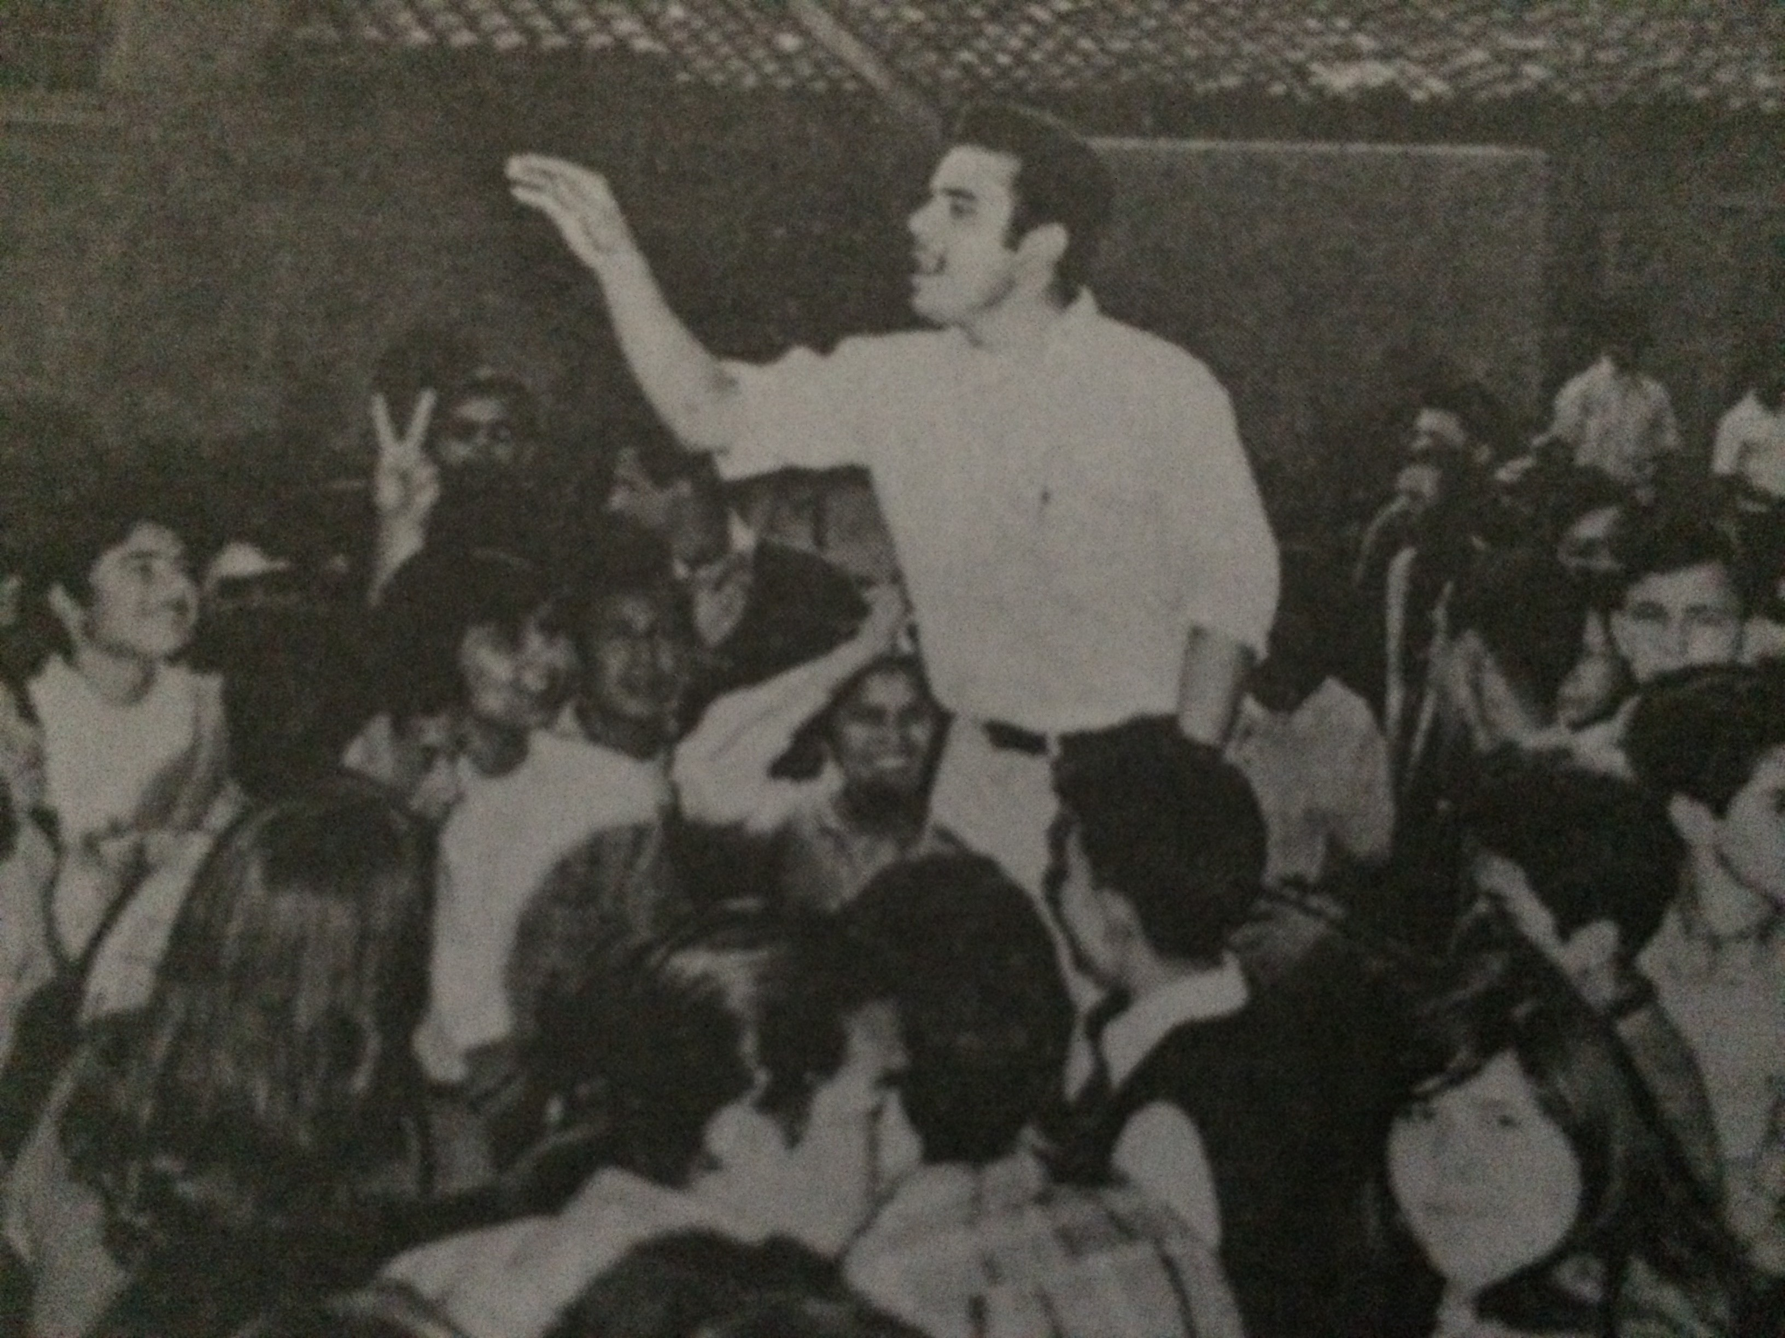
Lamc President Monte Perez

Slide 2
All Courses
Chicano 2 – The Mexican American in Contemporary Society
Chicano 7 – The Mexican American in The history of the United States I
Chicano 8 – The Mexican American in The History of the United States II
Chicano 19 – History of Mexico
Chicano 20 – The Mexican-American in California
Chicano 37 – Chicano Literature
Chicano 42 – Contemporary Mexican Literature
Chicano 44 – Mexican Civilization
Chicano 46 – Mexican American Folklore
Chicano 47 – The Mexican-American Woman in Society
Chicano 52 – Mexican Art-Modern
Chicano 54 – Mexican-American Arts in American Culture
Chicano 57 – Chicanas and Chicanos in Film
Chicano 58 – Latin American Dance Cultures
Chicano 71 – The Chicano in Los Angeles

Slide 3
Degrees offered
Social Justice Studies: Chicano/Chicana Studies Associate Degree for Transfer (ADT)
Associate of Arts (AA) Chicano Studies

Slide 4
LAMC President Monte Perez participating in the 1968 East L.A. Student Walkouts

Slide 5
50th Anniversary of the Zoot suit riots
From left to right: Joe Flores – Professor; Sal Castro – Mexican American educator and activist known for his role in the East L.A. School Walkouts; John Morales – Dept. Chair of the Chicano Studies Dept., LAMC

Slide 6
Meet Luis Rodriguez event
Chicano Studies event held at the LAMC campus featuring award winning poet, and writer, Luis Rodriguez, as a speaker

Slide 7
Black History Month Tribute
The Greater Community Missionary Baptist Church in Pacoima presented a Black History Month Program. John Morales (3rd from right), Dept. Chair of Chicano Studies in LAMC, was honored at the event for outstanding Community Service

Slide 8
M.E.Ch.A. display/Exhibit for Dia de los Muertos
Display created by Chicano Studies Students in the M.E.Ch.A. club at LA Mission College

Slide 9
Dia de los Muertos Event
Aztec dancers with Professor John Morales in the center during a Chicano Studies event

Slide 10
CHICANO STUDIES Event in LAMC
Chicano Studies Professor Jose Maldonado at an event in the LAMC auditorium.

Slide 11
Roaming graduation Event
Professor Jose Maldonado (right) celebrating the 2020 graduation of Chicano Studies students who earned their A.A. degree in Chicano Studies, by going to the students’ homes while maintaining safety precautions against covid-19

Slide 12
Fernando Espuelas visits lamc
Fernando Espuelas, Host of the Fernando Espuelas Show, with a Chicano Studies student in the Culinary Arts Institute, LAMC.

Slide 13
Olvera Street Field trip
Center: Dolores Huerta, Civil Rights activist and labor leader

Slide 14
ben Affleck joins lecture on a field trip
Chicano Studies students, while on a field trip at the La Plaza de Cultura y Artes, coincidentally met actor/celebrity Ben Affleck.

Slide 15
Tamayo restaurant and art gallery Field trip
Chicano Studies 52 students at the Tamayo Restaurant and Art Gallery

Slide 16
LAMC ZOOT SUIT EVENT
Ignacio Gomez (far left), artist; and LAMC President Monte Perez (2nd from right) with LAMC students dressed as zoot suiters

Slide 17
Zoot suit event panel
From left to right: Candice Forsythe, Eleanor mendiaz, William Shibley, Ignacio Gomez, Dr. Jorge Garcia

Slide 18
The ballad of Gregorio Cortez viewing
Flyer advertising the screening of the film “The Ballad of Gregorio Cortez” as part of a Chicano Studies Event.

Slide 19
International Students
International students taking Chicano Studies courses posing with LAMC president, Monte Perez, during a Chicano Studies event

Slide 20
Dolores Huerta labor institute event
A LAMC Chicano Studies student, addressing the panel during Q & A at the Dolores Huerta Labor Institute Event

Slide 21
High school students visit
Local High School Students visiting the Chicano Studies Resource Center

Slide 22
High school students visit
Local High School Students visiting the Chicano Studies Resource Center

Slide 23
Outreach
University Pathways medical Magnet Academy counselor, Khanh Truong, accepting a certificate of appreciation from the LAMC Chicano Studies Department

Slide 24
Poster of “The last brown Beret”
Hollywood screening of The Last Brown Beret at the Egyptian Theater. Daniel Mora, actor (far right)

